Slide 1
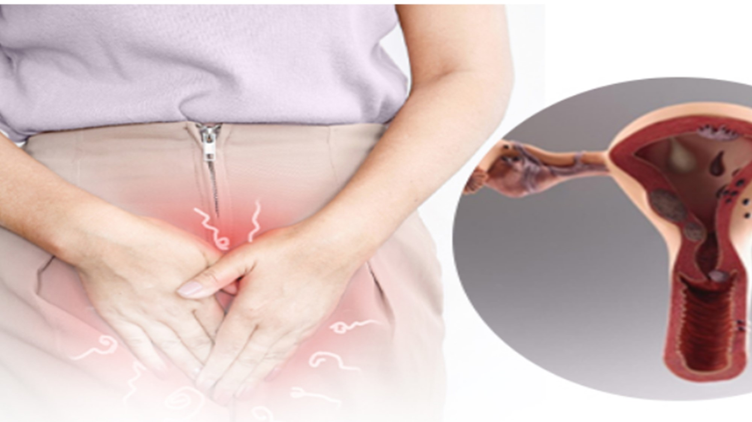
Abnormal Uterine Bleeding
Dr Geremew P- OB-Gyn R3
SEP 8, 2025

Slide 2
Objectives
Revise normal menstruation
Discuss the classification of abnormal uterine bleeding
Understand the evaluation of abnormal uterine bleeding
Discuss the management options for abnormal uterine bleeding
Dr Geremew

Slide 3
INTRODUCTION
Abnormal uterine bleeding (AUB) is a broad term that describes irregularities in the menstrual cycle involving frequency, regularity, duration, and volume of flow outside of pregnancy.
Up to one-third of women will experience abnormal uterine bleeding in their life,
Leading complaint to visit the Gynecology OPD
most commonly occurring at menarche and perimenopause
The commonest gynecologic indication for hysterectomy
Dr Geremew

Slide 4
Terms
Obsolete
Current
Menorrhagia
Menometrorrhagia
Metrorrhagia
Polyymenorrhea
Hypermenorrea
Oligomenorrhea
Dysfunctional uterine bleeding
Ammenorrhea
Heavy menstrual bleeding
Intermentrual bleeding
Postmenopausal bleeding
Dr Geremew

Slide 5
Nomenclature
Acute AUB
  “an episode of bleeding in a woman who is not pregnant of sufficient quantity to require immediate intervention to prevent further blood loss.”
Chronic AUB
  “bleeding from the uterine corpus that is abnormal in duration, volume, and/or frequency and has been present for the majority of the last 6 months.”
Dr Geremew
Notes:
DYNA notes
heavy menstrual bleeding (formerly menorrhagia) technically defined as episode of blood loss > 80 mL, but clinical definition should be based on patient's perception of excessive blood loss⁽⁴⁾
acute AUB is an episode of heavy bleeding that requires immediate intervention to prevent further blood loss^{(1, 2, 5)}
chronic AUB^{(1, 2, 3, 4)}
bleeding from uterine corpus that is
abnormal in volume, frequency, and duration and has been present for most of past 6 months
heavy menstrual bleeding (volume) - excessive menstrual blood loss which interferes with woman's physical, emotional, social, and material quality of life
frequency (normal every 21-38 days)
infrequent - bleeding at intervals > 35-38 days apart (also called oligomenorrhea)
frequent - bleeding at intervals < 21-24 days apart (also called polymenorrhea)
absent - no bleeding in 90-day period
duration (normal 3-8 days)
prolonged - > 8 days in duration
shortened - < 3 days in duration
intermenstrual AUB (formerly metrorrhagia)^{(1, 3)}
irregular anovulatory bleeding occurring between periods
may be random or may occur on same day of each cycle
bleeding outside reproductive age⁽³⁾
postmenopausal bleeding
precocious menstruation - bleeding before age 9 years

Slide 6
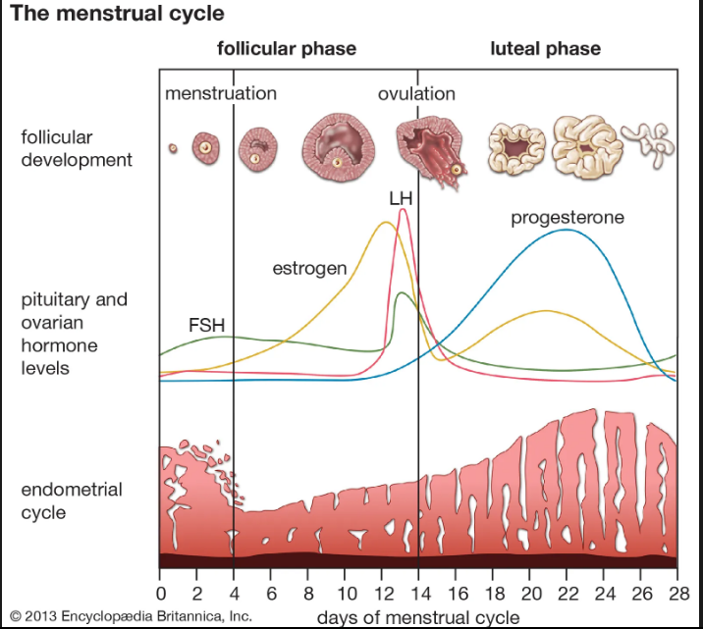
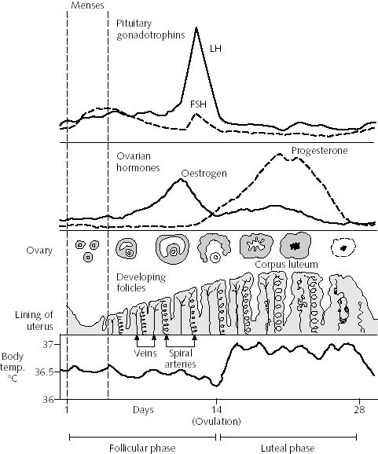
What’s normal bleeding?
Dr Geremew

Slide 7
Phases of Reproductive Cycle
Follicular phase
  Onset of menses to LH surge
  14 days (varies)
  Dominant follicle: greatest number of granulosa cells and FSH receptors
Ovulation: 24-36 hours after LH surge
Luteal phase:
  LH surge to menses
  14 days (constant)
Menses:
  Involution of corpus luteum
  Decrease progesterone and estrogen
  20-60 cc of dark blood and endometrial tissue
Dr Geremew

Slide 8
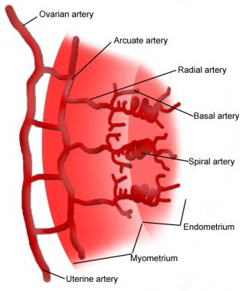
Phases of Reproductive Cycle
Endometrium
  Proliferative phase
  Secretory phase
  menses
Dr Geremew

Slide 9
Menstrual bleeding stops IF:
Prostaglandins cause contractions and expulsion
Endometrial healing and cessation of bleeding with increasing estrogen
Dr Geremew

Slide 10
What’s normal?
Character | Descriptive term | Normal limits
Frequency of menses | Frequent Normal Infrequent | <21 21-38 >38
Regularity of menses: | Absent Regular Irregular | No Bleeding Variation ± 2-20 Variation >20
Duration of flow, | Prolonged Normal Shortened | >8 3-8 <3
Volume of monthly blood loss(ml) | Heavy Normal Light | >80 5-80 <5
Dr Geremew

Slide 11
Etiology of AUB
Dr Geremew

Slide 12
Most Common Causes AUB
Pre-menarchal: Foreign body
Reproductive age: Gestational event
Post-menopausal:Atrophy
Dr Geremew

Slide 13
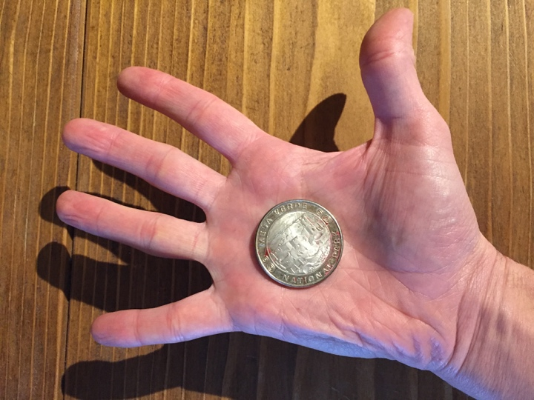
FIGO AUB classification : PALM-COEIN
  PALM-COEIN
    Polyp
    Adenomyosis
    Leiomyoma
    Malignancy and hyperplasia
    Coagulopathy
    Ovulatory disorders
    Endometrium
    Iatrogenic
    Not classified
Dr Geremew

Slide 14
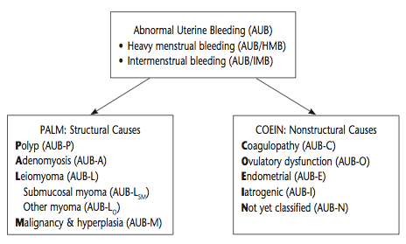
Classification: PALM-COEIN
Causes of AUB in nonpregnant reproductive-aged women
International Federation of Gynecology and Obstetrics, 2011
Dr Geremew
Notes:
Prior definitions had some gray areas.
A new classification system known by acronym “PALM-COIEIN” was introduced by FIGO (Int’l Federation of Gynecology & Obstetrics) in 2011, to create universal nomenclature system to describe uterine bleeding abnormalities in reproductive-aged women; ACOG supports adopting PALM-COEIN classification/nomenclature to standardize terminology used to describe AUB
Classifies by: bleeding pattern & etiology
“Dysfunctional uterine bleeding” is a term that was often used synonomously with AUB in literature but meant AUB for which no cause was identifiable; article recommends discontinuing use of the term.
In diagram above:
Coagulopathy: ex) von Willebrand
Ovulatory: unopposed estrogen, typically endocrinopathy (PCOS)
-So first steps are is determining acute vs. chronic
-Acute AUB: episode of heavy bleeding that is sufficient amount to require immediate intervention to prevent further blood loss (clinician’s judgment); can be spontaneous or in context of chronic AUB
-chronic AUB = AUB present for most of prior 6 months

Slide 15
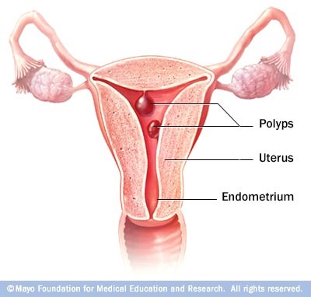
Structural causes (PALM)
Polyps – AUB-P
◦ endocervical or endometrial
Detected by ultrasound or sonohysterography
Often irregular, light bleeding
Dr Geremew

Slide 16
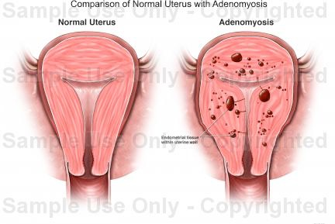
Structural causes (PALM)
Adenomyosis –AUB-A
presence of heterotropic endometrial tissue in myometrium and myometrial hypertrophy
Controversial as a cause of bleeding
Diagnosed with ultrasound, MRI, pathology
Dr Geremew
Notes:
◦ based on ultrasound findings (or magnetic resonance imaging if available)
◦ rare in adolescents

Slide 17
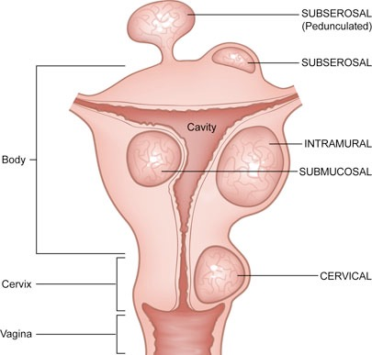
Structural causes (PALM)
Leiomyoma – AUB-L
    ◦ Submucous, Intramural, Subserosal
Diagnosed with pelvic exam, ultrasound, MRI, CT
Heavy, regular bleeding
Dr Geremew
Notes:
Fibroids

Slide 18
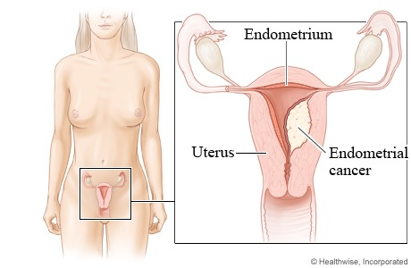
Structural causes (PALM)
Malignancy and hyperplasia – AUB-M
Diagnosed by biopsy
Irregular bleeding
Dr Geremew

Slide 19
Non-structural causes: COEIN
  Coagulopathies or bleeding disorders
  Ovulatory dysfunction
  Endometrial
  Iatrogenic sources (medications, smoking)
  Not yet classified
Dr Geremew
Notes:
Ovulatory dysfunction:
- Wide spectrum (amenorrhea to heavy bleeding)
- Physiologic
- immature hypothlamis-pituitary-ovarian axis seen in adolescence
- perimenopause
- lactation
- pregnancy
- pathologic
- hyperandrogenic anovulation
-PCOS
- congenital adrenal hyperplasia
- androgen-producing tumors
- hypothalamic dysfunction (anorexia nervosa...)
- hyperprolactinemia
- thyroid disease (hyper or hypo)
- primary pituitary disease
- premature ovarian failure
- medications
Endometrial (predictable, cyclic bleeding and no ohter cause identified)
Iatrogenic
- hormonal contraceptives
- SSRIs and TCAs
- antipsychotics (1st generation and risperdone)
- anticonvulsants
- antibiotics
- smoking (may reduce levels of contraceptive hormones)
Not yet classified
- chronic endometritis
- AVMs
- myometrial hypertrophy

Slide 20
Causes of AUB - Anovulatory
Most common cause of AUB
Many reasons for anovulation
    Physiologic: HPO Axis, lactation, pregnancy, perimenopause
    PCOS: chronic anovulation with hyperestrogen
    Stress, weight change, exercise
    Endocrine
      ◦ Thyroid, Hyperprolactinaemia
      ◦ Secreting tumors
Dr Geremew

Slide 21
Diagnosis
History
  Acute vs Chronic
  Characterize bleeding pattern
  Menstrual bleeding hx (incl. severity and associated pain)
  Fam Hx: AUB/ bleeding disorders
  drugs: anticoagualants , NSAID, OCP, antidepresants, anticonvalecents,
Physical
  PCOS: obesity, hirsutism, acne
  Thyroid dysfunction: cold/heat intolerance, dry skin, lethargy, proptosis
  DM: acanthosis nigricans
  Bleeding disorder: petechiae, pallor, signs of hypovolemia
  Pelvic exam:◦ Is it from the uterus?!
Dr Geremew

Slide 22
Diagnosis: Labs and Imaging
Labs
  Pregnancy test
  CBC
  Targeted screening for bleeding disorder (when indicated)
  TSH
  Gonorrhea/Chlamydia in high risk patients
Imaging:
  TVUS
  Sonohysterography
  Hysteroscopy
  MRI
Endometrial biopsy
Dr Geremew
Notes:
-Ovulatory status usually can be determined by presence of cyclic menses
-Hypothyroidism and hyperthyroidism are also associated w/AUB (hypothyroidism more commonly)
Imaging
-primary imaging of uterus for evaluation of AUB is transvaginal US
-if further evaluation of uterine cavity needed, sonohysterography (aka saline infusion sonohysterography) or hysteroscopy is recommended.
-MRI is not a primary imaging modality for AUB

Slide 23
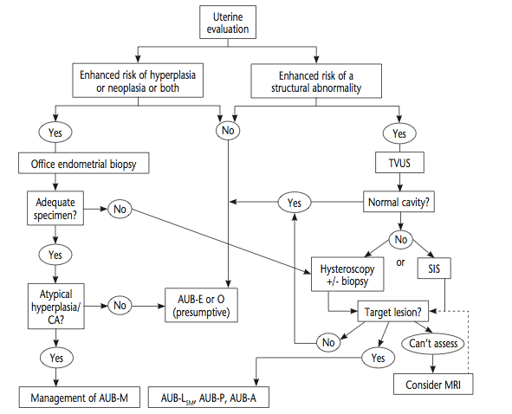
Uterine Evaluation
Practice bulletin no. 128: diagnosis of abnormal uterine bleeding in reproductive-aged women. Obstet Gynecol. 2012 Jul;120(1):197-206. doi: 10.1097/AOG.0b013e318262e320.
Dr Geremew
Notes:
Uterine evaluation. Guided by the medical history and other elements of the clinical situation, such as patient age, presence of an apparent chronic ovulatory disorder, or presence of other risk factors for endometrial hyperplasia or malignancy.
If increased risk, endometrial biopsy is probably warranted
If risk of structural anomaly, particularly if previous medical therapy has been unsuccessful, evaluation of the uterus should TVUS. Unless the ultrasound image indicates a normal endometrial cavity, it will be necessary to use either or both hys- teroscopy and sonohysterography to determine whether target lesions are present.
If inconclusive or virginal: MRI may be of value, if available.
Abbreviations: AUB, abnormal uterine bleeding; AUB-P, polyp; AUB-A, adenomyosis; AUB-LSM, leiomyoma submucosal; AUB- M, malignancy and hyperplasia; AUB-O, ovulatory dysfunction; AUB-E, endometrial; CA, carcinoma; MRI, magnetic resonance imag- ing; SIS, sonohysterography; TVUS, transvaginal ultrasonography. Reprinted from Munro MG. Abnormal Uterine Bleeding. Cambridge: Cambridge University Press; 2010.^p4^p7

Slide 24
Who should be offered Endometrial biopsy(emb)?
◦ women aged > 45 years
◦ women with persistent bleeding refractory to medication,
regardless of age
◦ women aged < 45 years with risk factors for endometrial
cancer, such as
  ◦ obesity (body mass index > 30 kg/m²)
  ◦ nulliparity
  ◦ hypertension
  ◦ irregular menstruation
  ◦ polycystic ovary syndrome
  ◦ diabetes
  ◦ hereditary nonpolyposis colorectal cancer
  ◦ family history of endometrial cancer
Practice bulletin no. 128: diagnosis of abnormal uterine bleeding in reproductive-aged women. Obstet Gynecol. 2012 Jul;120(1):197-206. doi: 10.1097/AOG.0b013e318262e320.
Dr Geremew
Notes:
ACOG:
Endometrial tissue sampling should be performed in patients with AUB who are older than 45 years as a first-line test (see Fig. 2). Endometrial sampling also should be performed in patients younger than 45 years with a history of unopposed estrogen expo- sure (such as seen in obesity or PCOS), failed medical management, and persistent AUB

Slide 25
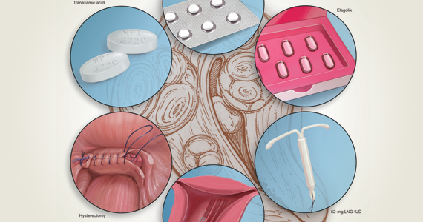
Management
Expectant
Medical
surgical
Dr Geremew

Slide 26
Management
Medical management should be initial treatment for most patients
Depends on
  The etiology of the AUB
  Fertility desire
  The clinical stability of the patient
  Other medical comorbidities
Dr Geremew
Notes:
Studies are limited for treatments of acute AUB

Slide 27
Acute abnormal uterine bleeding
Hormonal methods are first-line in medical management.
Intravenous (IV) conjugated equine estrogen, combined oral contraceptive pills (OCPs), and oral progestins are all options for treatment of acute AUB.
Tranexamic acid prevents fibrin degradation and can be used to treated acute AUB.
Tamponade of the uterine bleeding with a Foley bulb is a mechanical option for treatment of acute AUB.
Desmopressin, administered intranasally, subcutaneously, or intravenously, can be given for acute AUB secondary to the coagulopathy von Willebrand disease
Dr Geremew

Slide 28
Chronic AUB : PALM
Polyps are treated through surgical resection.
Adenomyosis : hysterectomy. Less often, adenomyomectomy.
Leiomyomas (fibroids) can be treated through medical or surgical management
  surgical options include uterine artery embolization, endometrial ablation,Myomectomy or hysterectomy.
  Medical management options include a levonorgestrel-releasing intrauterine device (IUD), GnRH agonists, systemic progestins, and tranexamic acid with non-steroidal anti-inflammatory drugs (NSAIDs).
Malignancy or hyperplasia can be treated through surgery, +/- adjuvant treatment, or palliative therapy, such as radiotherapy.
Dr Geremew

Slide 29
Chronic AUB: COEIN
Coagulopathies :treated with tranexamic acid or desmopressin
Ovulatory dysfunction can be treated through lifestyle modification in women with obesity, PCOS
  Endocrine disorders: use of appropriate medications, such as cabergoline for hyperprolactinemia and levothyroxine for hypothyroidism.
Endometrial disorders have no specific treatment as mechanisms are not clearly understood.
Iatrogenic causes of AUB should be managed based on the offending drug and/or drugs.
Not otherwise classified causes of AUB include entities such as endometritis and AVMs. Endometritis can be treated with antibiotics and AVMs with embolization.
Dr Geremew

Slide 30
Postmenopausal bleeding
Should be considered malignancy until proven
Atrophy : treated with topical estrogens
Dr Geremew

Slide 31
Differential diagnosis
  Based on anatomic location or system:
    Vulva: Benign growths or malignancy
    Vagina: Benign growths, sexually transmitted infections, vaginitis, malignancy, trauma, foreign bodies
    Cervix: Benign growths, sexually transmitted infections, malignancy
    Fallopian tubes and ovaries: Pelvic inflammatory disease, malignancy
    Urinary tract: Infections, malignancy
    Gastrointestinal tract: Inflammatory bowel disease, Behçet syndrome
    Pregnancy complications: Spontaneous abortion, ectopic pregnancy, placenta previa
Dr Geremew

Slide 32
Complications
Acute abnormal uterine bleeding
  severe anemia,
  hypotension, shock,
  death
Chronic abnormal uterine bleeding
  anemia,
  infertility, and
  endometrial cancer
Dr Geremew

Slide 33
Summary
Abnormal uterine bleeding is common across women life
Familiarizing with the normal pattern of menstruation vital to diagnose AUB
PALM COEIN is a useful acronym for common etiologies of AUB, with PALM representing structural causes and COEIN representing non-structural causes
Women older than 45 years of age, or women who are younger than 45 with risk factors for malignancy require endometrial sampling as part of the evaluation for AUB
Treatment is based on etiology, desire for fertility, and medical comorbidities.
Dr Geremew

Slide 34
THANK YOU!
Dr Geremew

